Slide 1
Urban Marine Pollution
5/XX/2024

Slide 2


Shreya
Trevor
Stephanie
Tianxiao
Xiaofan
The Team

Slide 3
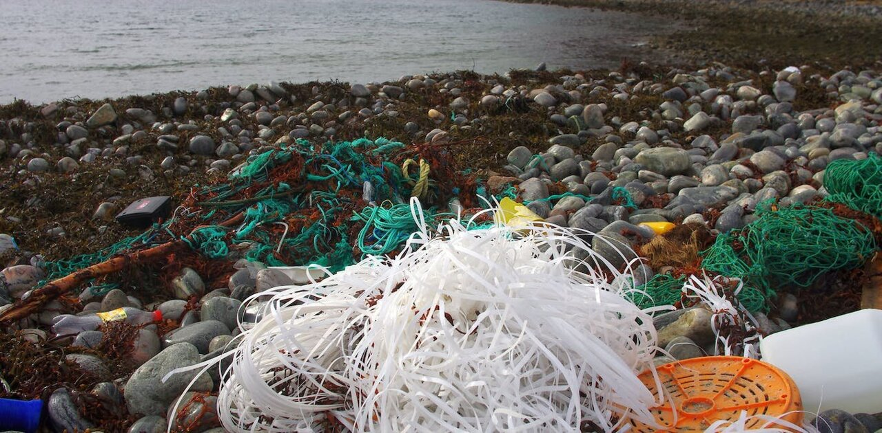
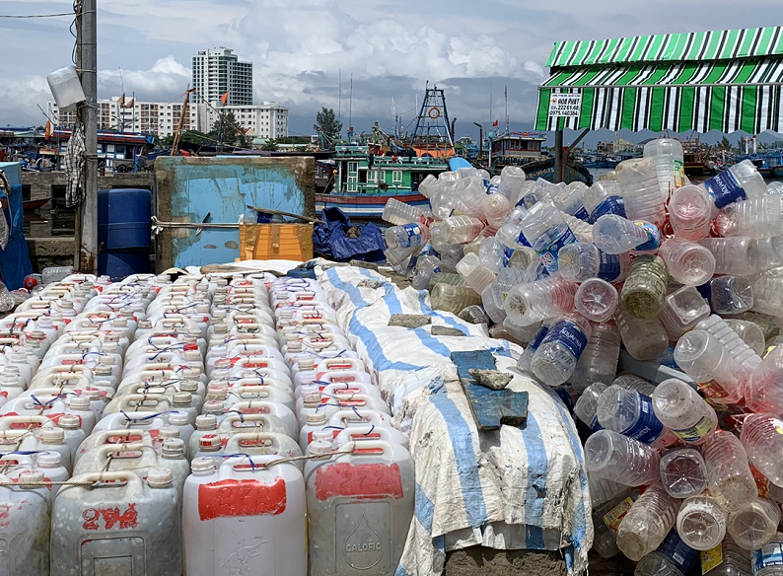
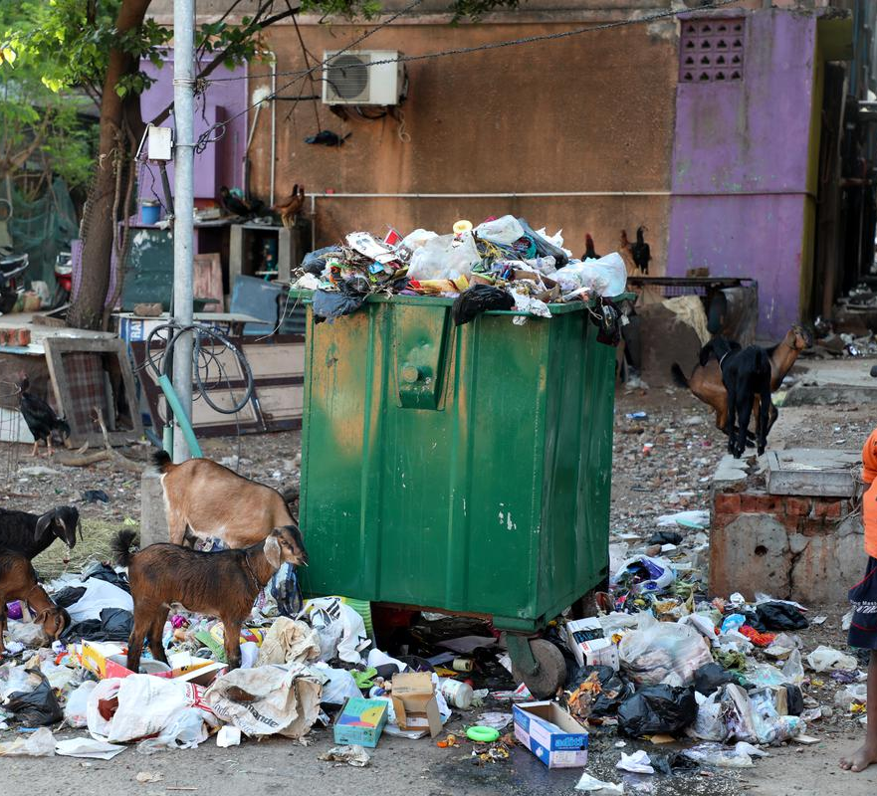
Plastics by the Numbers
11 million
Add your second bullet point here
Add your third bullet point here

Slide 4
Title and Content Layout with Chart

Slide 5
Two Content Layout with Table
First bullet point here
Second bullet point here
Third bullet point here
Class | Group 1 | Group 2
Class 1 | 82 | 95
Class 2 | 76 | 88
Class 3 | 84 | 90

Slide 6
Two Content Layout with SmartArt
First bullet point here
Second bullet point here
Third bullet point here
Group A
Group B
Group C

Slide 7
Add a Slide Title - 1

Slide 8
Add a Slide Title - 2

Slide 9
Add a Slide Title - 3

Slide 11
Add a Slide Title - 4

Slide 12
Add a Slide Title - 5

